Slide 1
INTRODUCTION TO
ALGORITHMS
FOURTH EDITION

Slide 2
LECTURE NOTES FOR CHAPTER 4
Divide-and-Conquer

Slide 3
CHAPTER 4 OVERVIEW
Recall the divide-and-conquer paradigm, which we used for merge sort:
Divide the problem into one or more subproblems that are smaller instances of the same problem.
Conquer the subproblems by solving them recursively.
Base case: If the subproblems are small enough, just solve them by brute force.
Combine the subproblem solutions to form a solution to the original problem.
Use a recurrence to characterize the running time of a divide-and-conquer algorithm. Solving the recurrence gives us the asymptotic running time.
A recurrence is a function is defined in terms of
one or more base cases, and
itself, with smaller arguments.

Slide 4
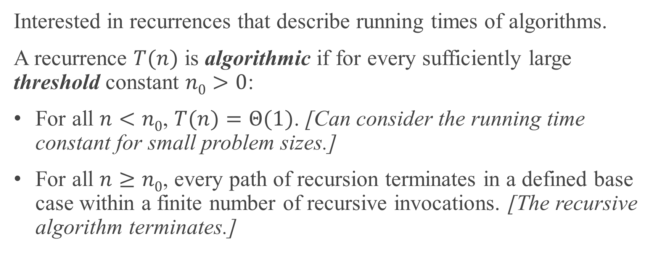
ALGORITHMIC RECURRENCES
Interested in recurrences that describe running times of algorithms.
A recurrence $T(n)$ is algorithmic if for every sufficiently large threshold constant $n0>0$:
For all $n<n0$, $T(n)=Θ(1)$. [Can consider the running time constant for small problem sizes.]
For all $n≥n0$, every path of recursion terminates in a defined base case within a finite number of recursive invocations. [The recursive algorithm terminates.]

Slide 5
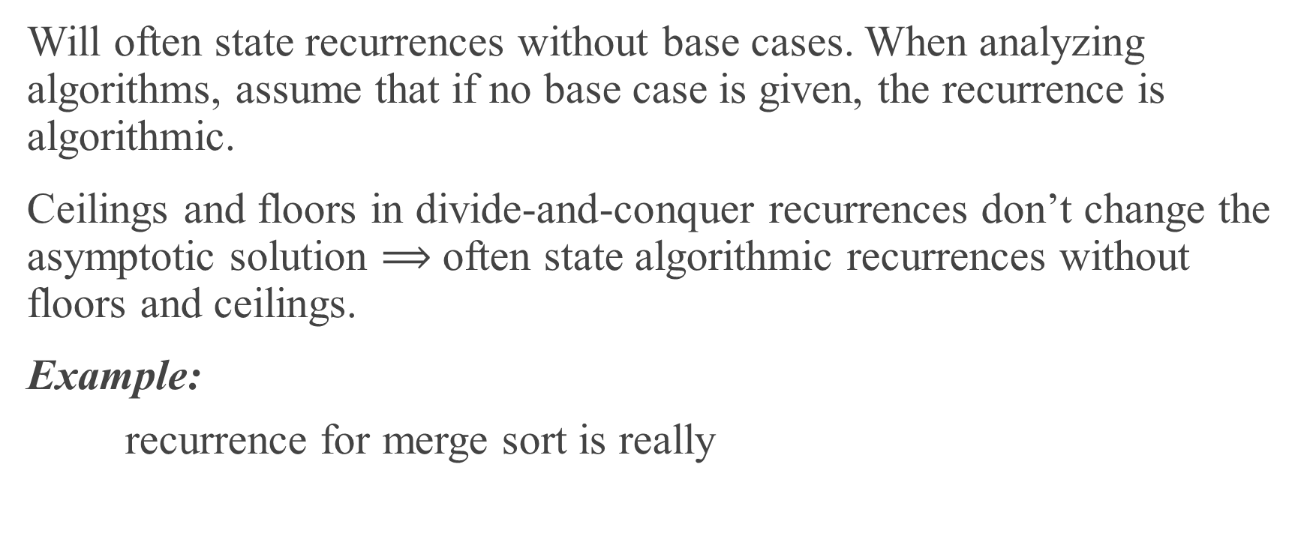
CONVENTIONS
Will often state recurrences without base cases. When analyzing algorithms, assume that if no base case is given, the recurrence is algorithmic.
Ceilings and floors in divide-and-conquer recurrences don’t change the asymptotic solution $⟹$often state algorithmic recurrences without floors and ceilings.
Example:
recurrence for merge sort is really

Slide 6

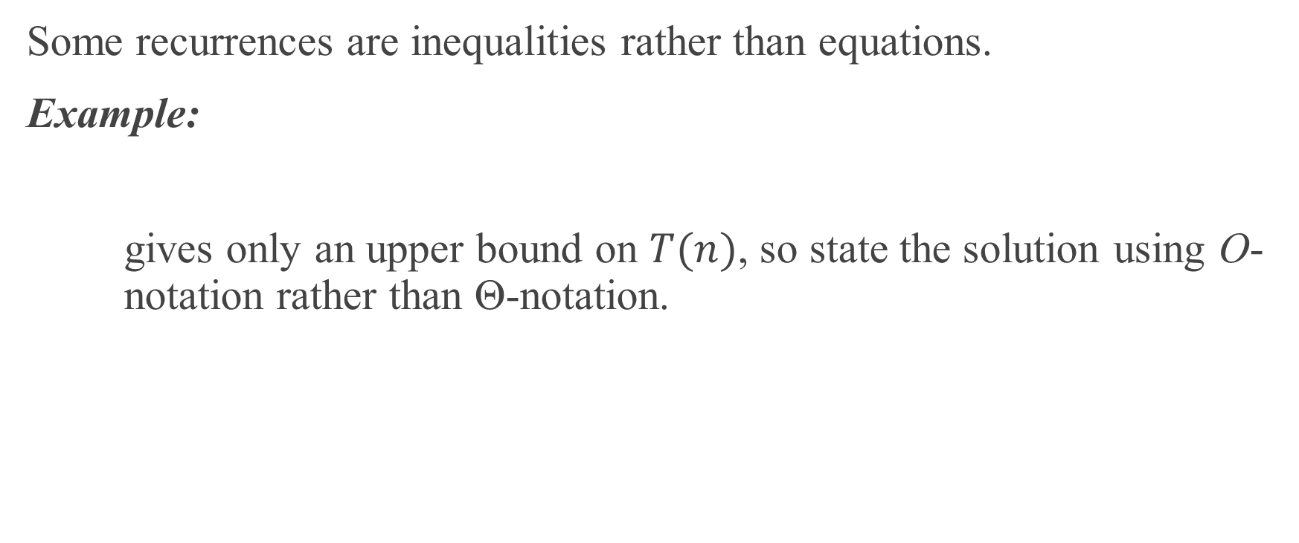
CONVENTIONS (continued)
Some recurrences are inequalities rather than equations.
Example:
gives only an upper bound on $T(n)$, so state the solution using O-notation rather than Θ-notation.

Slide 7
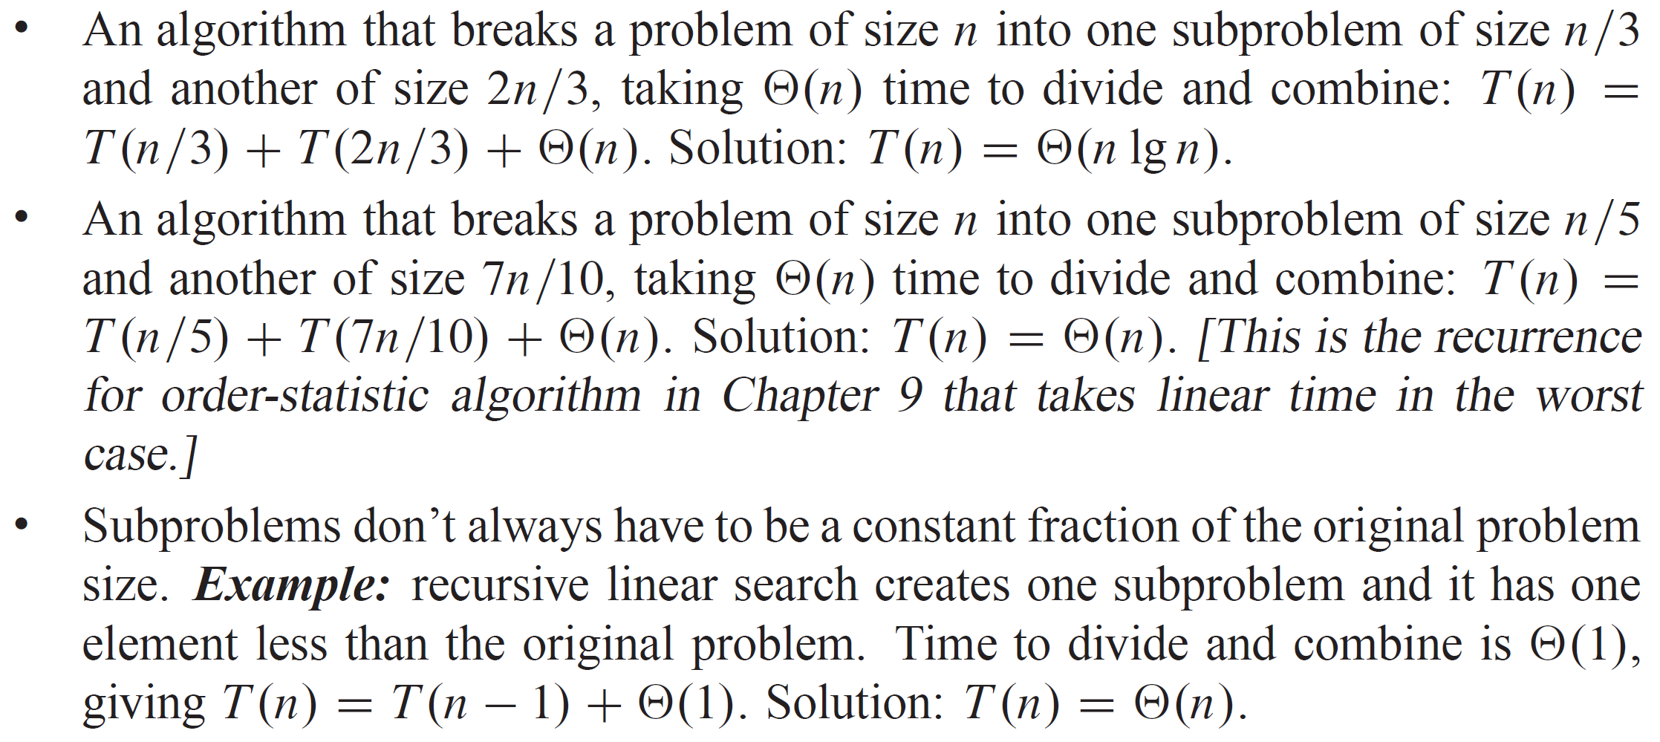
EXAMPLES OF RECURRENCES
$T(n)=2 T(n/2)+Θ(n)$

Slide 8
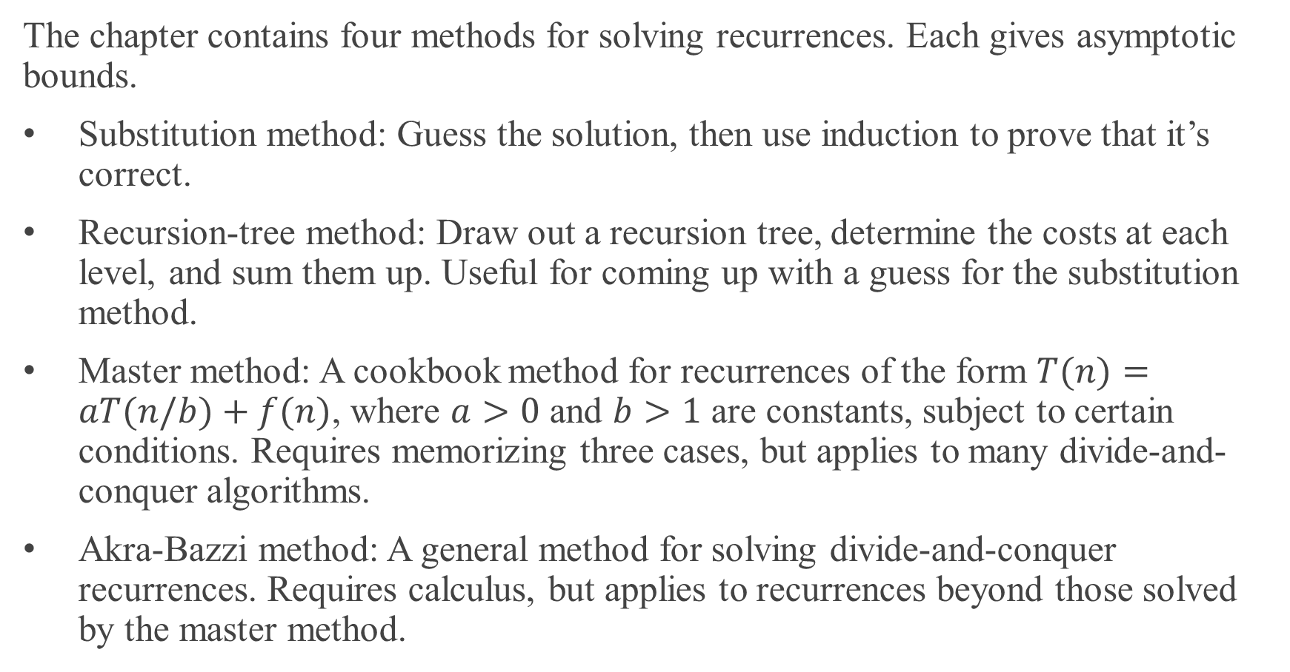
METHODS FOR SOLVING RECURRENCES
The chapter contains four methods for solving recurrences. Each gives asymptotic bounds.
Substitution method: Guess the solution, then use induction to prove that it’s correct.
Recursion-tree method: Draw out a recursion tree, determine the costs at each level, and sum them up. Useful for coming up with a guess for the substitution method.
Master method: A cookbook method for recurrences of the form $T(n)=aT(n/b)+f(n)$, where $a>0$ and $b>1$ are constants, subject to certain conditions. Requires memorizing three cases, but applies to many divide-and-conquer algorithms.
Akra-Bazzi method: A general method for solving divide-and-conquer recurrences. Requires calculus, but applies to recurrences beyond those solved by the master method.

Slide 9
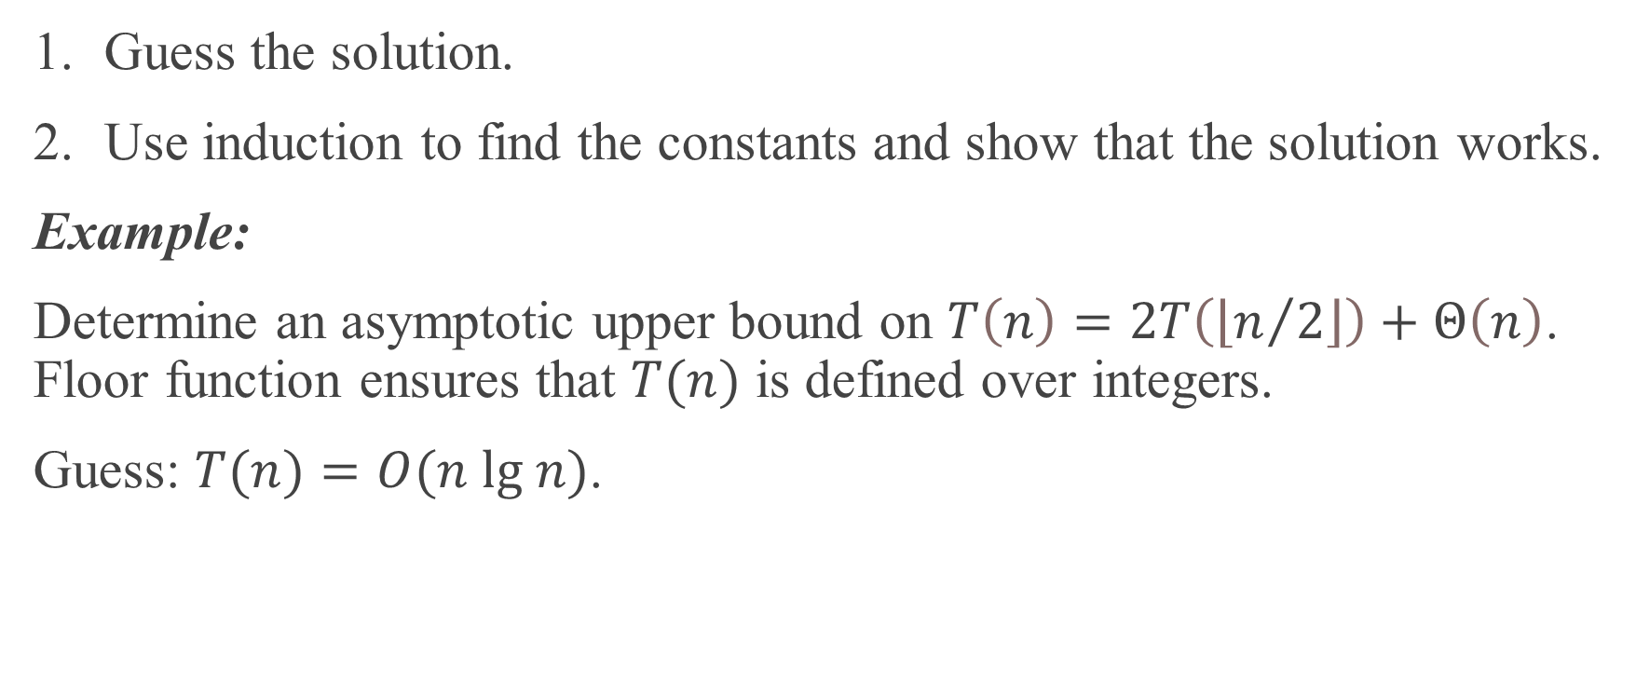
SUBSTITUTION METHOD
Guess the solution.
Use induction to find the constants and show that the solution works.
Example:
Determine an asymptotic upper bound on $T\left(n\right)=2T\left(\left\lfloor n/2\right\rfloor \right)+Θ\left(n\right)$. Floor function ensures that $T(n)$ is defined over integers.
Guess: $T(n)=O(n lg n)$.

Slide 10
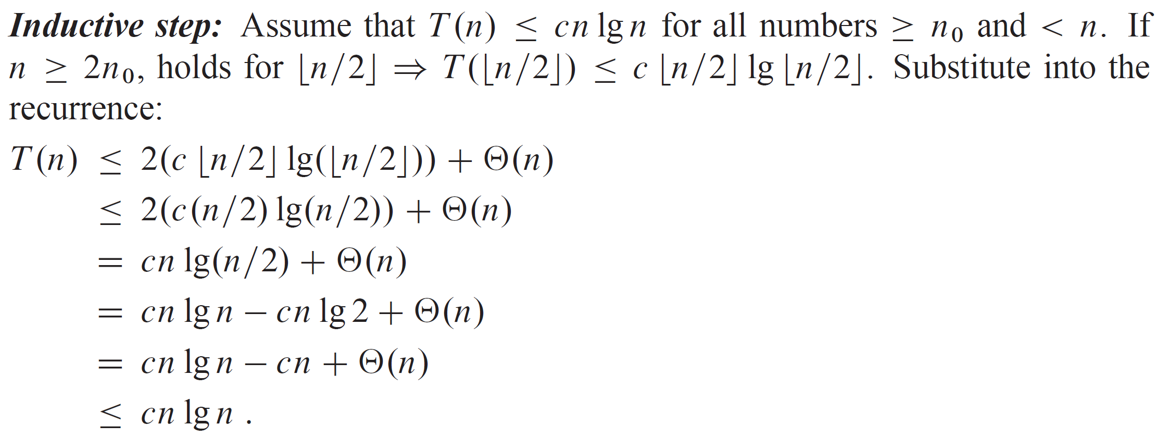
SUBSTITUTION METHOD (continued)

Slide 11
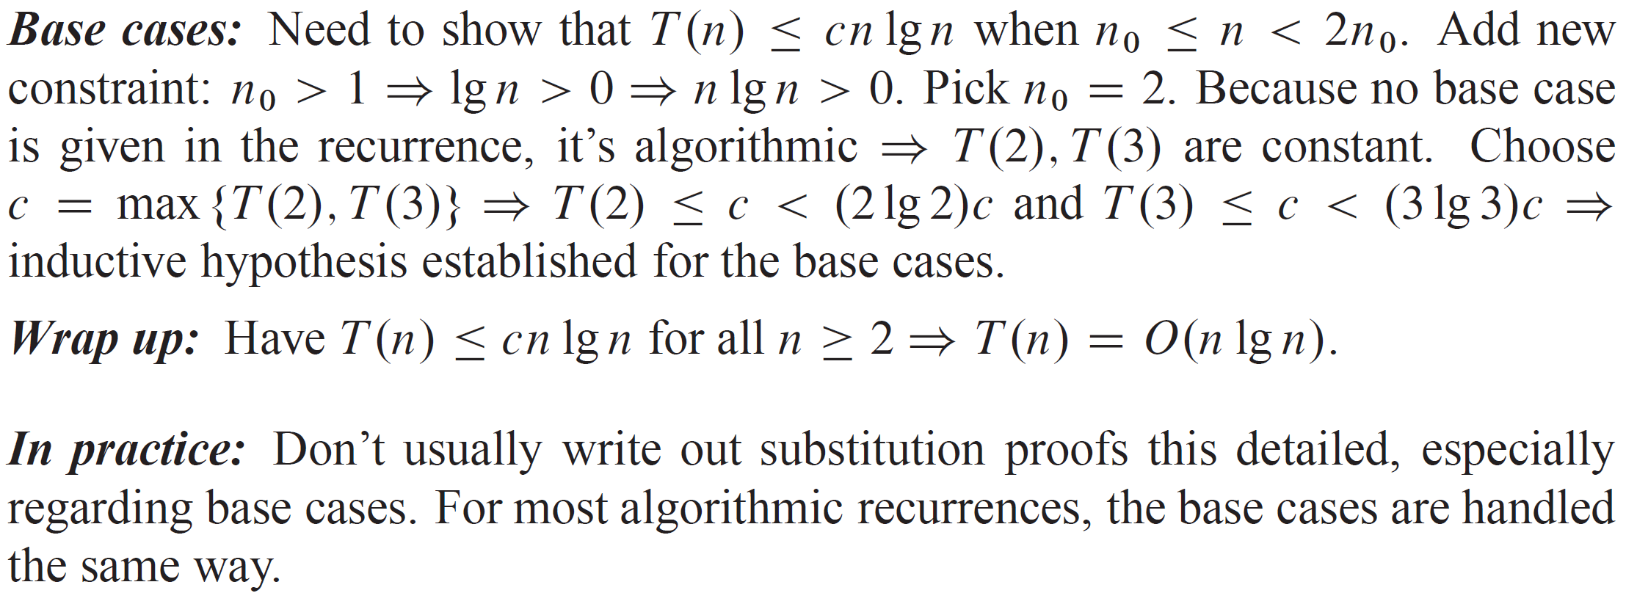
SUBSTITUTION METHOD (continued)

Slide 12
MAKING A GOOD GUESS
No general way to make a good guess. Experience helps. Can also draw out a recursion tree.
When the additive term uses asymptotic notation
Name the constant in the additive term.
Show the upper (O) and lower (ꭥ) bounds separately. Might need to use different constants for each.
Example:
Important: We get to name the constant hidden in the asymptotic notation (c in this case), but we do not get to choose it, other than assume that it’s enough to handle the base case of the recursion.

Slide 13
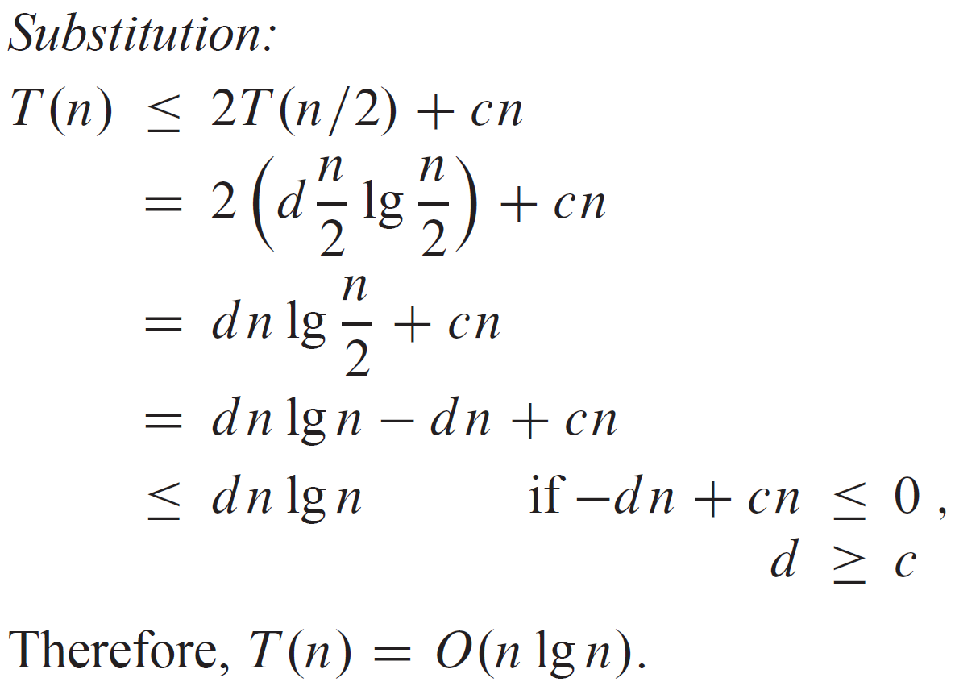

SUBSTITUTION METHOD (CONTINUED)
Upper bound:
Guess: $T(n)≤d n lg⁡n$ for some positive constant $d$. This is the inductive hypothesis.
Important: We get to both name and choose the constant in the inductive hypothesis (𝑑 in this case). It OK for the constant in the inductive hypothesis (𝑑) to depend on the constant hidden in the asymptotic notation (𝑐).

Slide 14
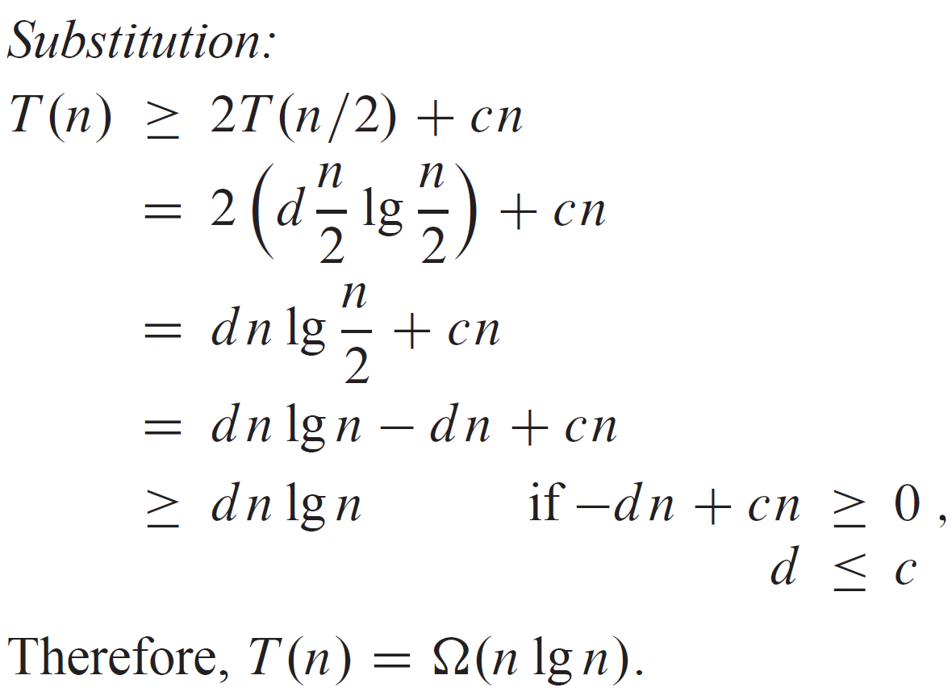
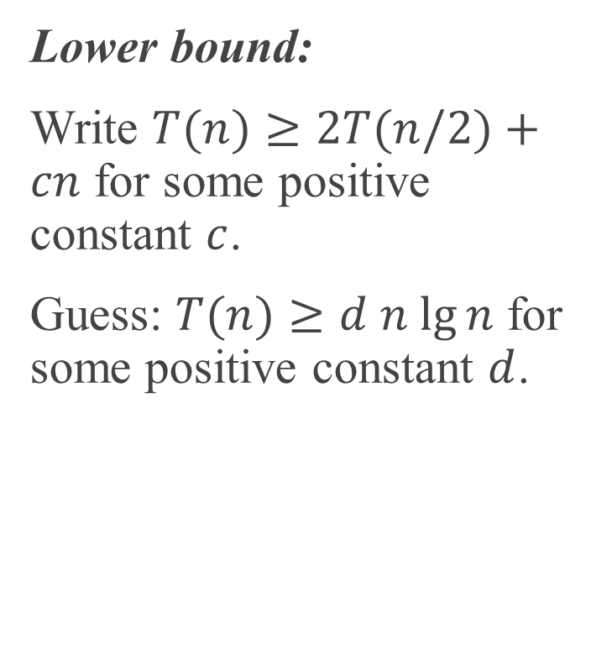
SUBSTITUTION METHOD (CONTINUED)
Lower bound:
Write $T(n)≥2T(n/2)+cn$ for some positive constant $c$.
Guess: $T(n)≥d n lg⁡n$ for some positive constant $d$.
Therefore, $T(n)=Θ(n lg⁡n)$. [For this particular recurrence, we can use $d=c$ for both the upper-bound and lower-bound proofs. That won’t always be the case.]

Slide 15
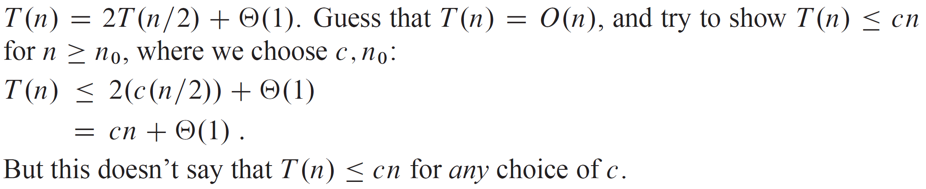
SUBTRACTING A LOW-ORDER TERM
Might guess the right asymptotic bound, but the math doesn’t go through in the proof. Resolve by subtracting a lower-order term.
Example:

Slide 16
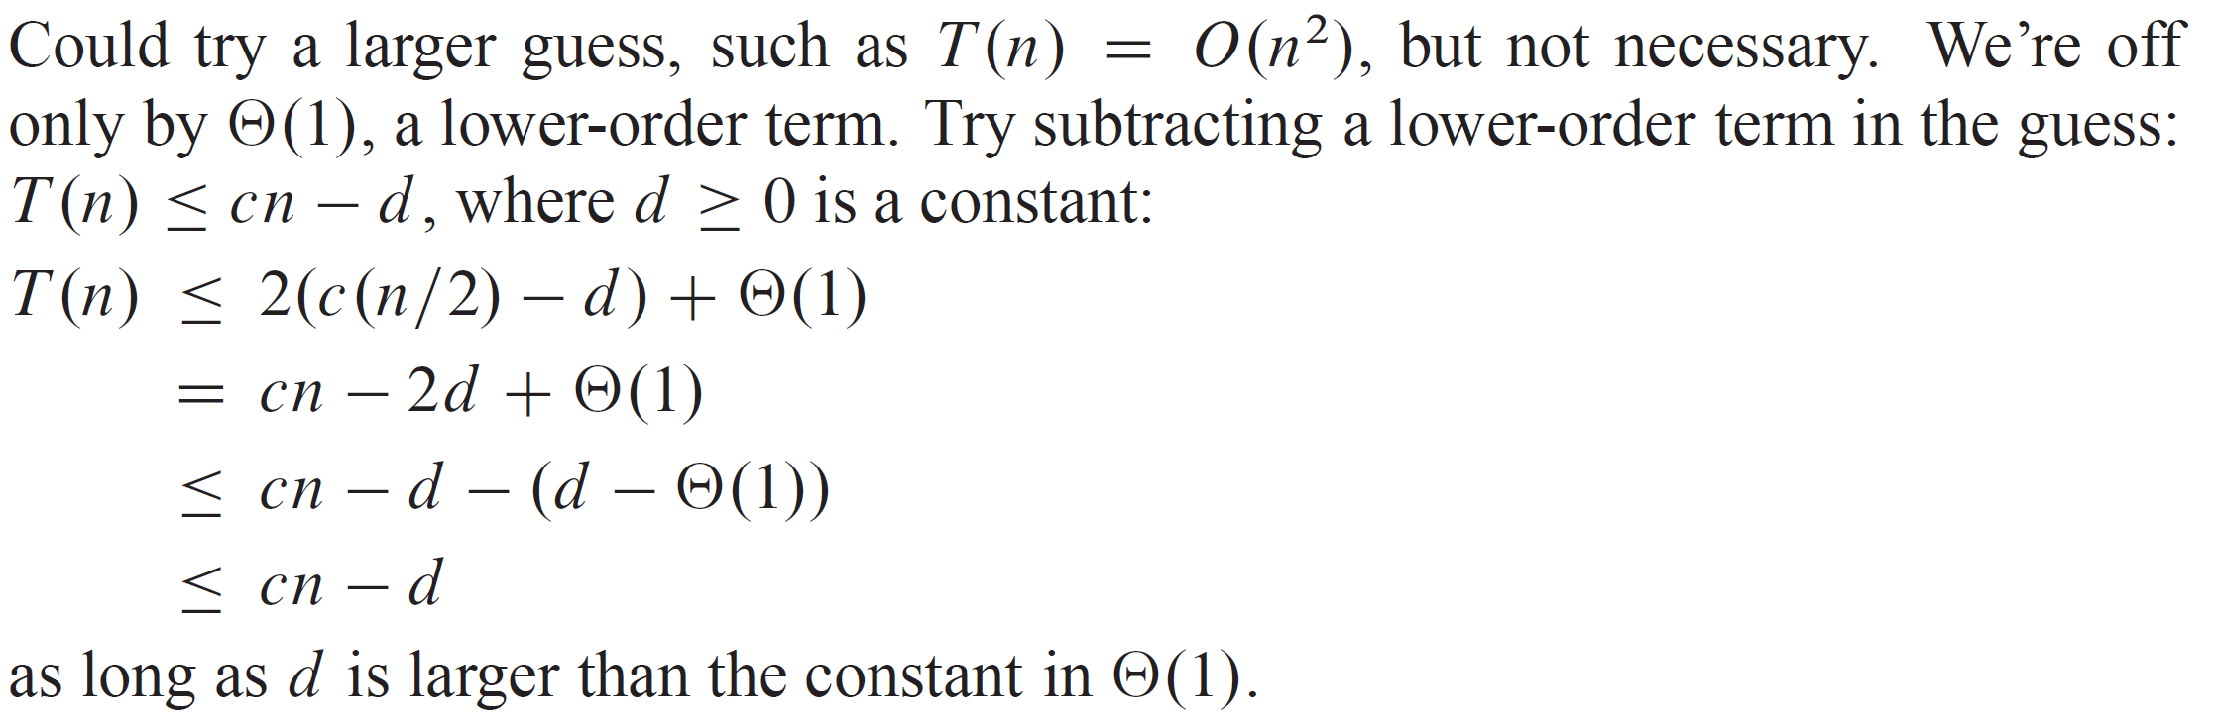
SUBTRACTING A LOW-ORDER TERM (continued)

Slide 17
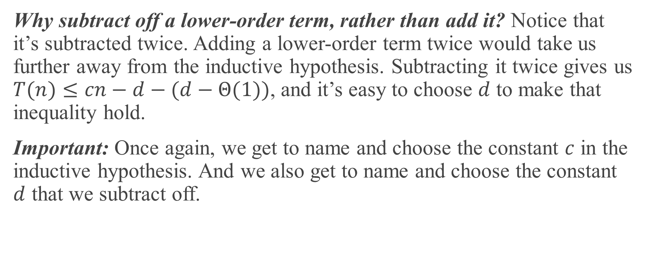
SUBTRACTING A LOW-ORDER TERM (continued)
Why subtract off a lower-order term, rather than add it? Notice that it’s subtracted twice. Adding a lower-order term twice would take us further away from the inductive hypothesis. Subtracting it twice gives us $T(n)≤cn−d−(d−Θ(1))$, and it’s easy to choose $d$ to make that inequality hold.
Important: Once again, we get to name and choose the constant $c$ in the inductive hypothesis. And we also get to name and choose the constant $d$ that we subtract off.

Slide 18
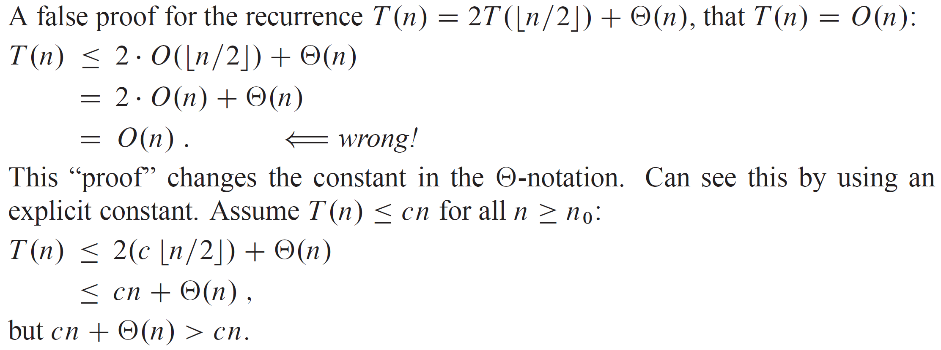
SUBTRACTING A LOW-ORDER TERM (continued)
Be careful when using asymptotic notation

Slide 19
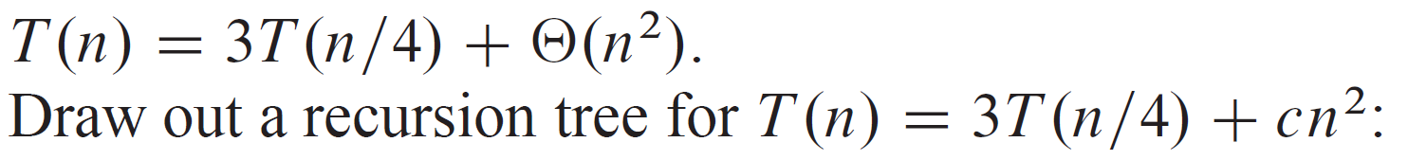
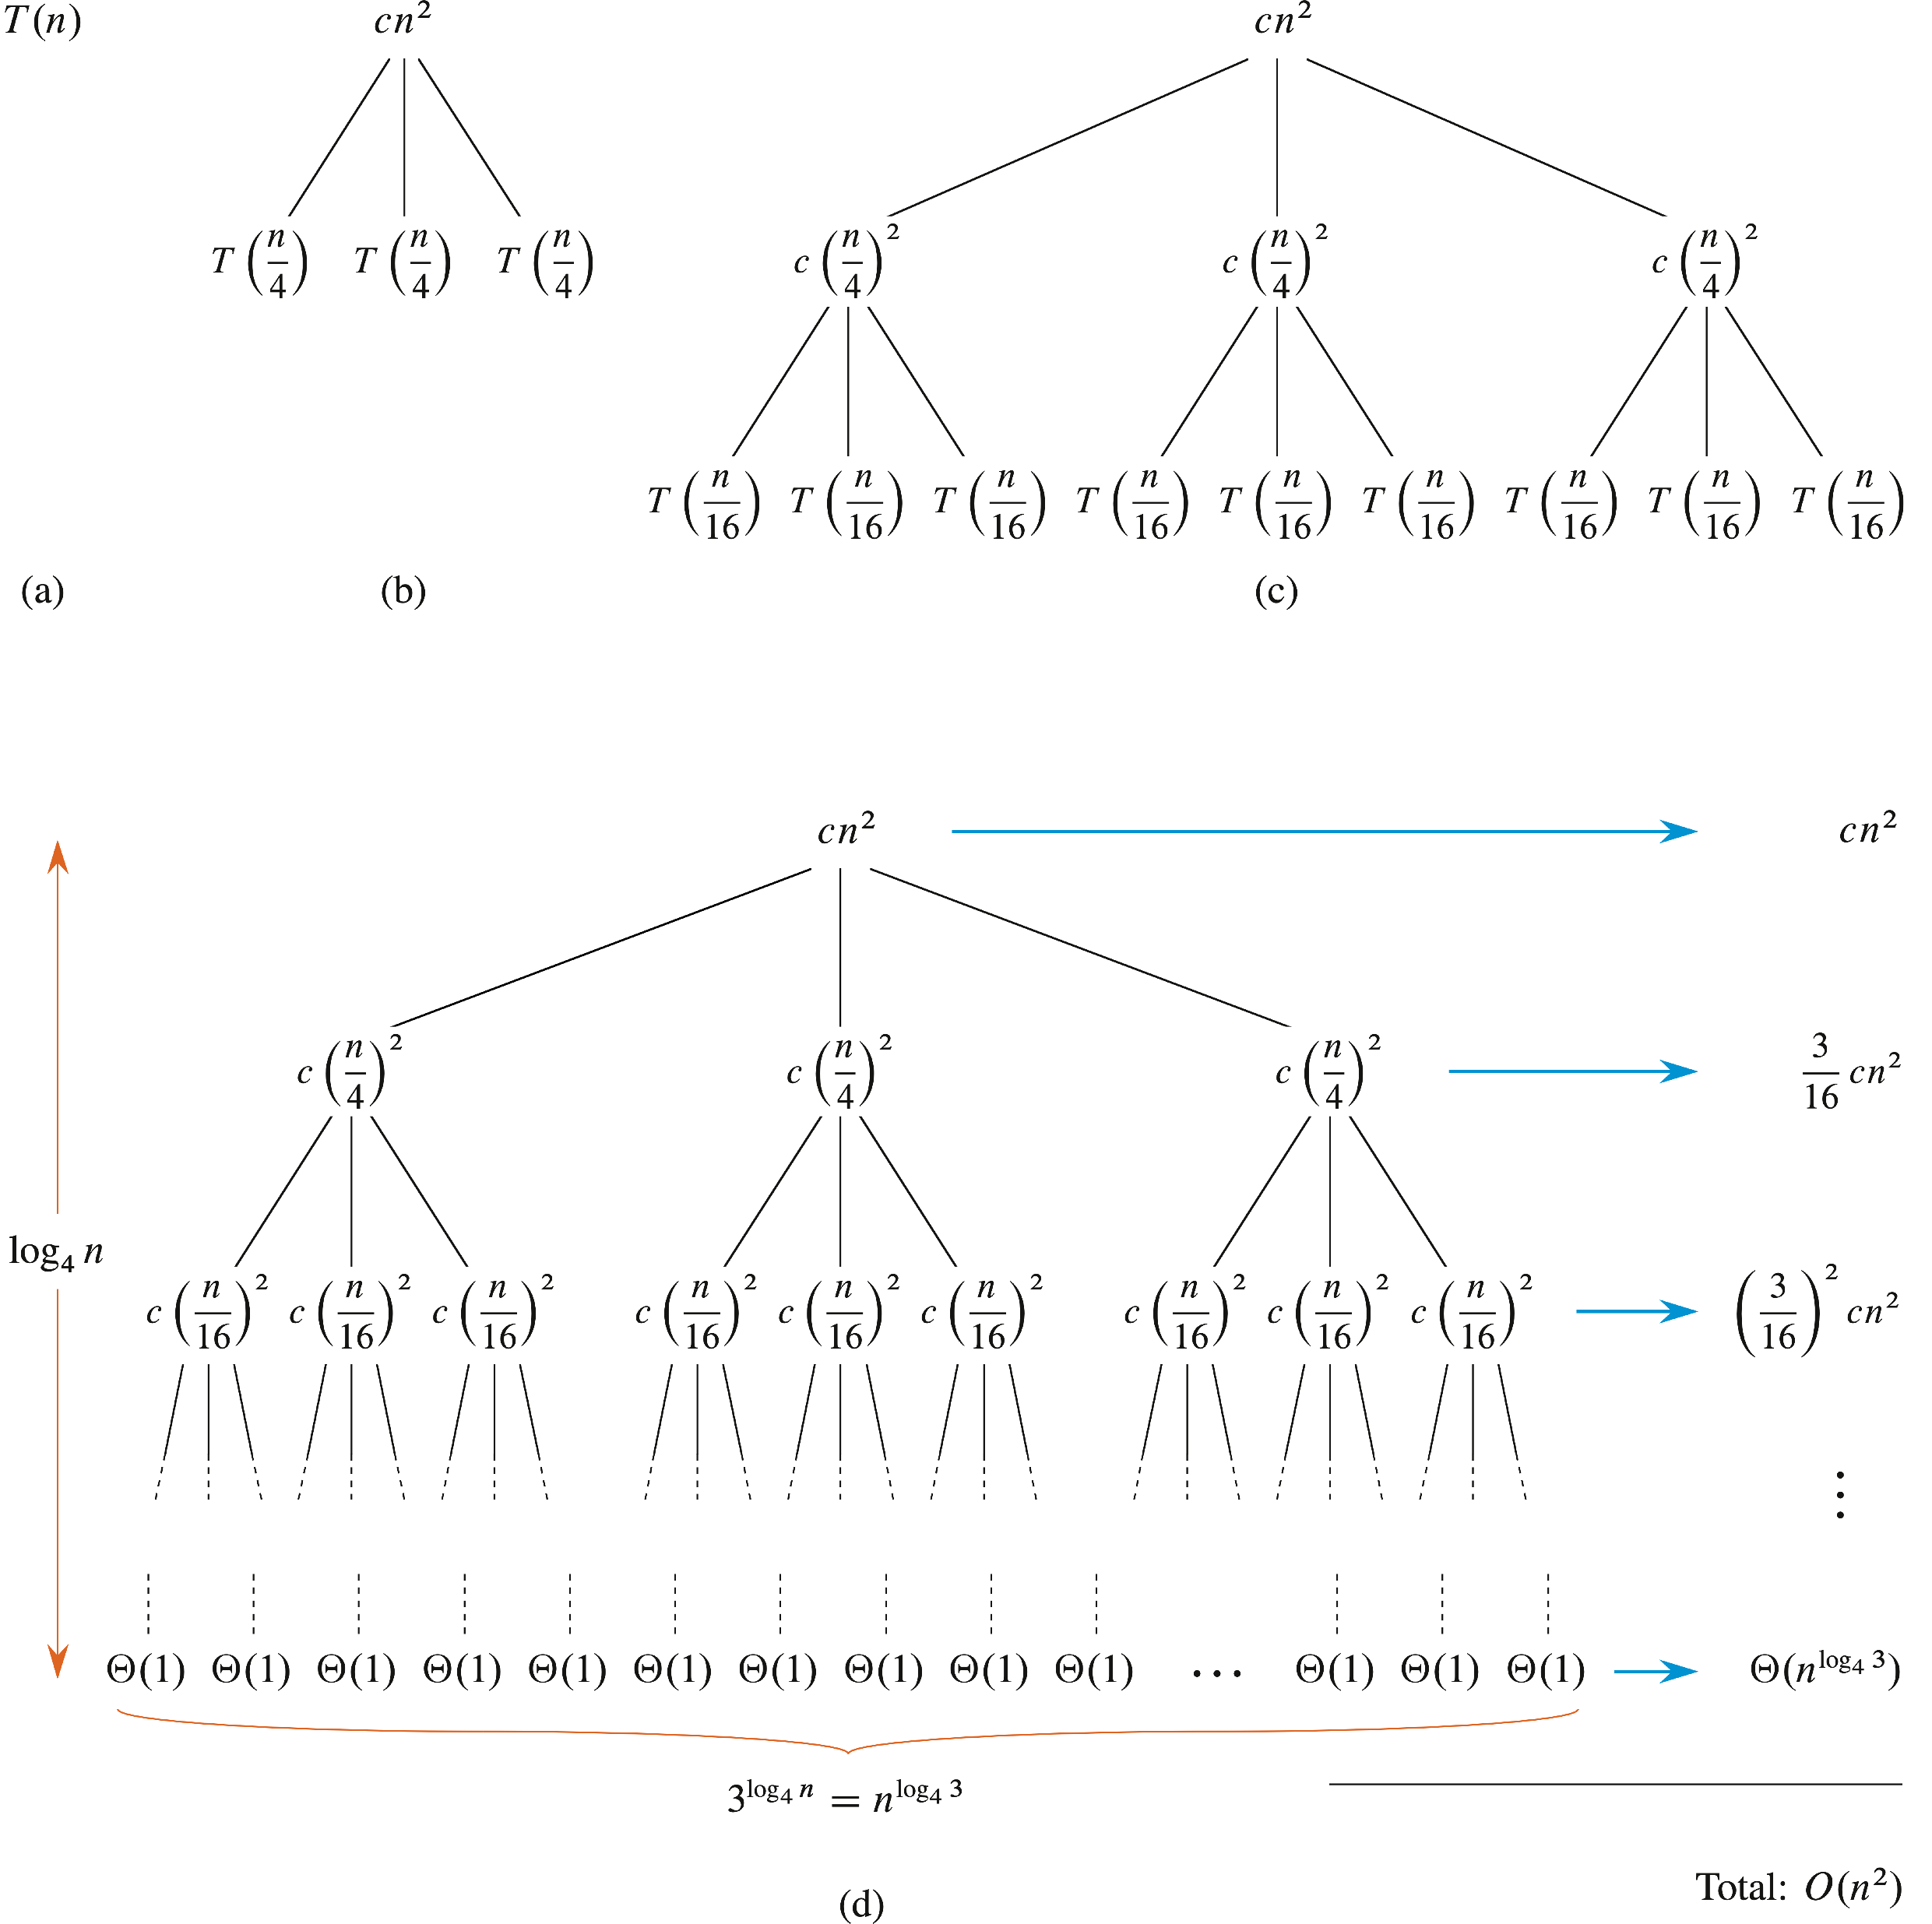

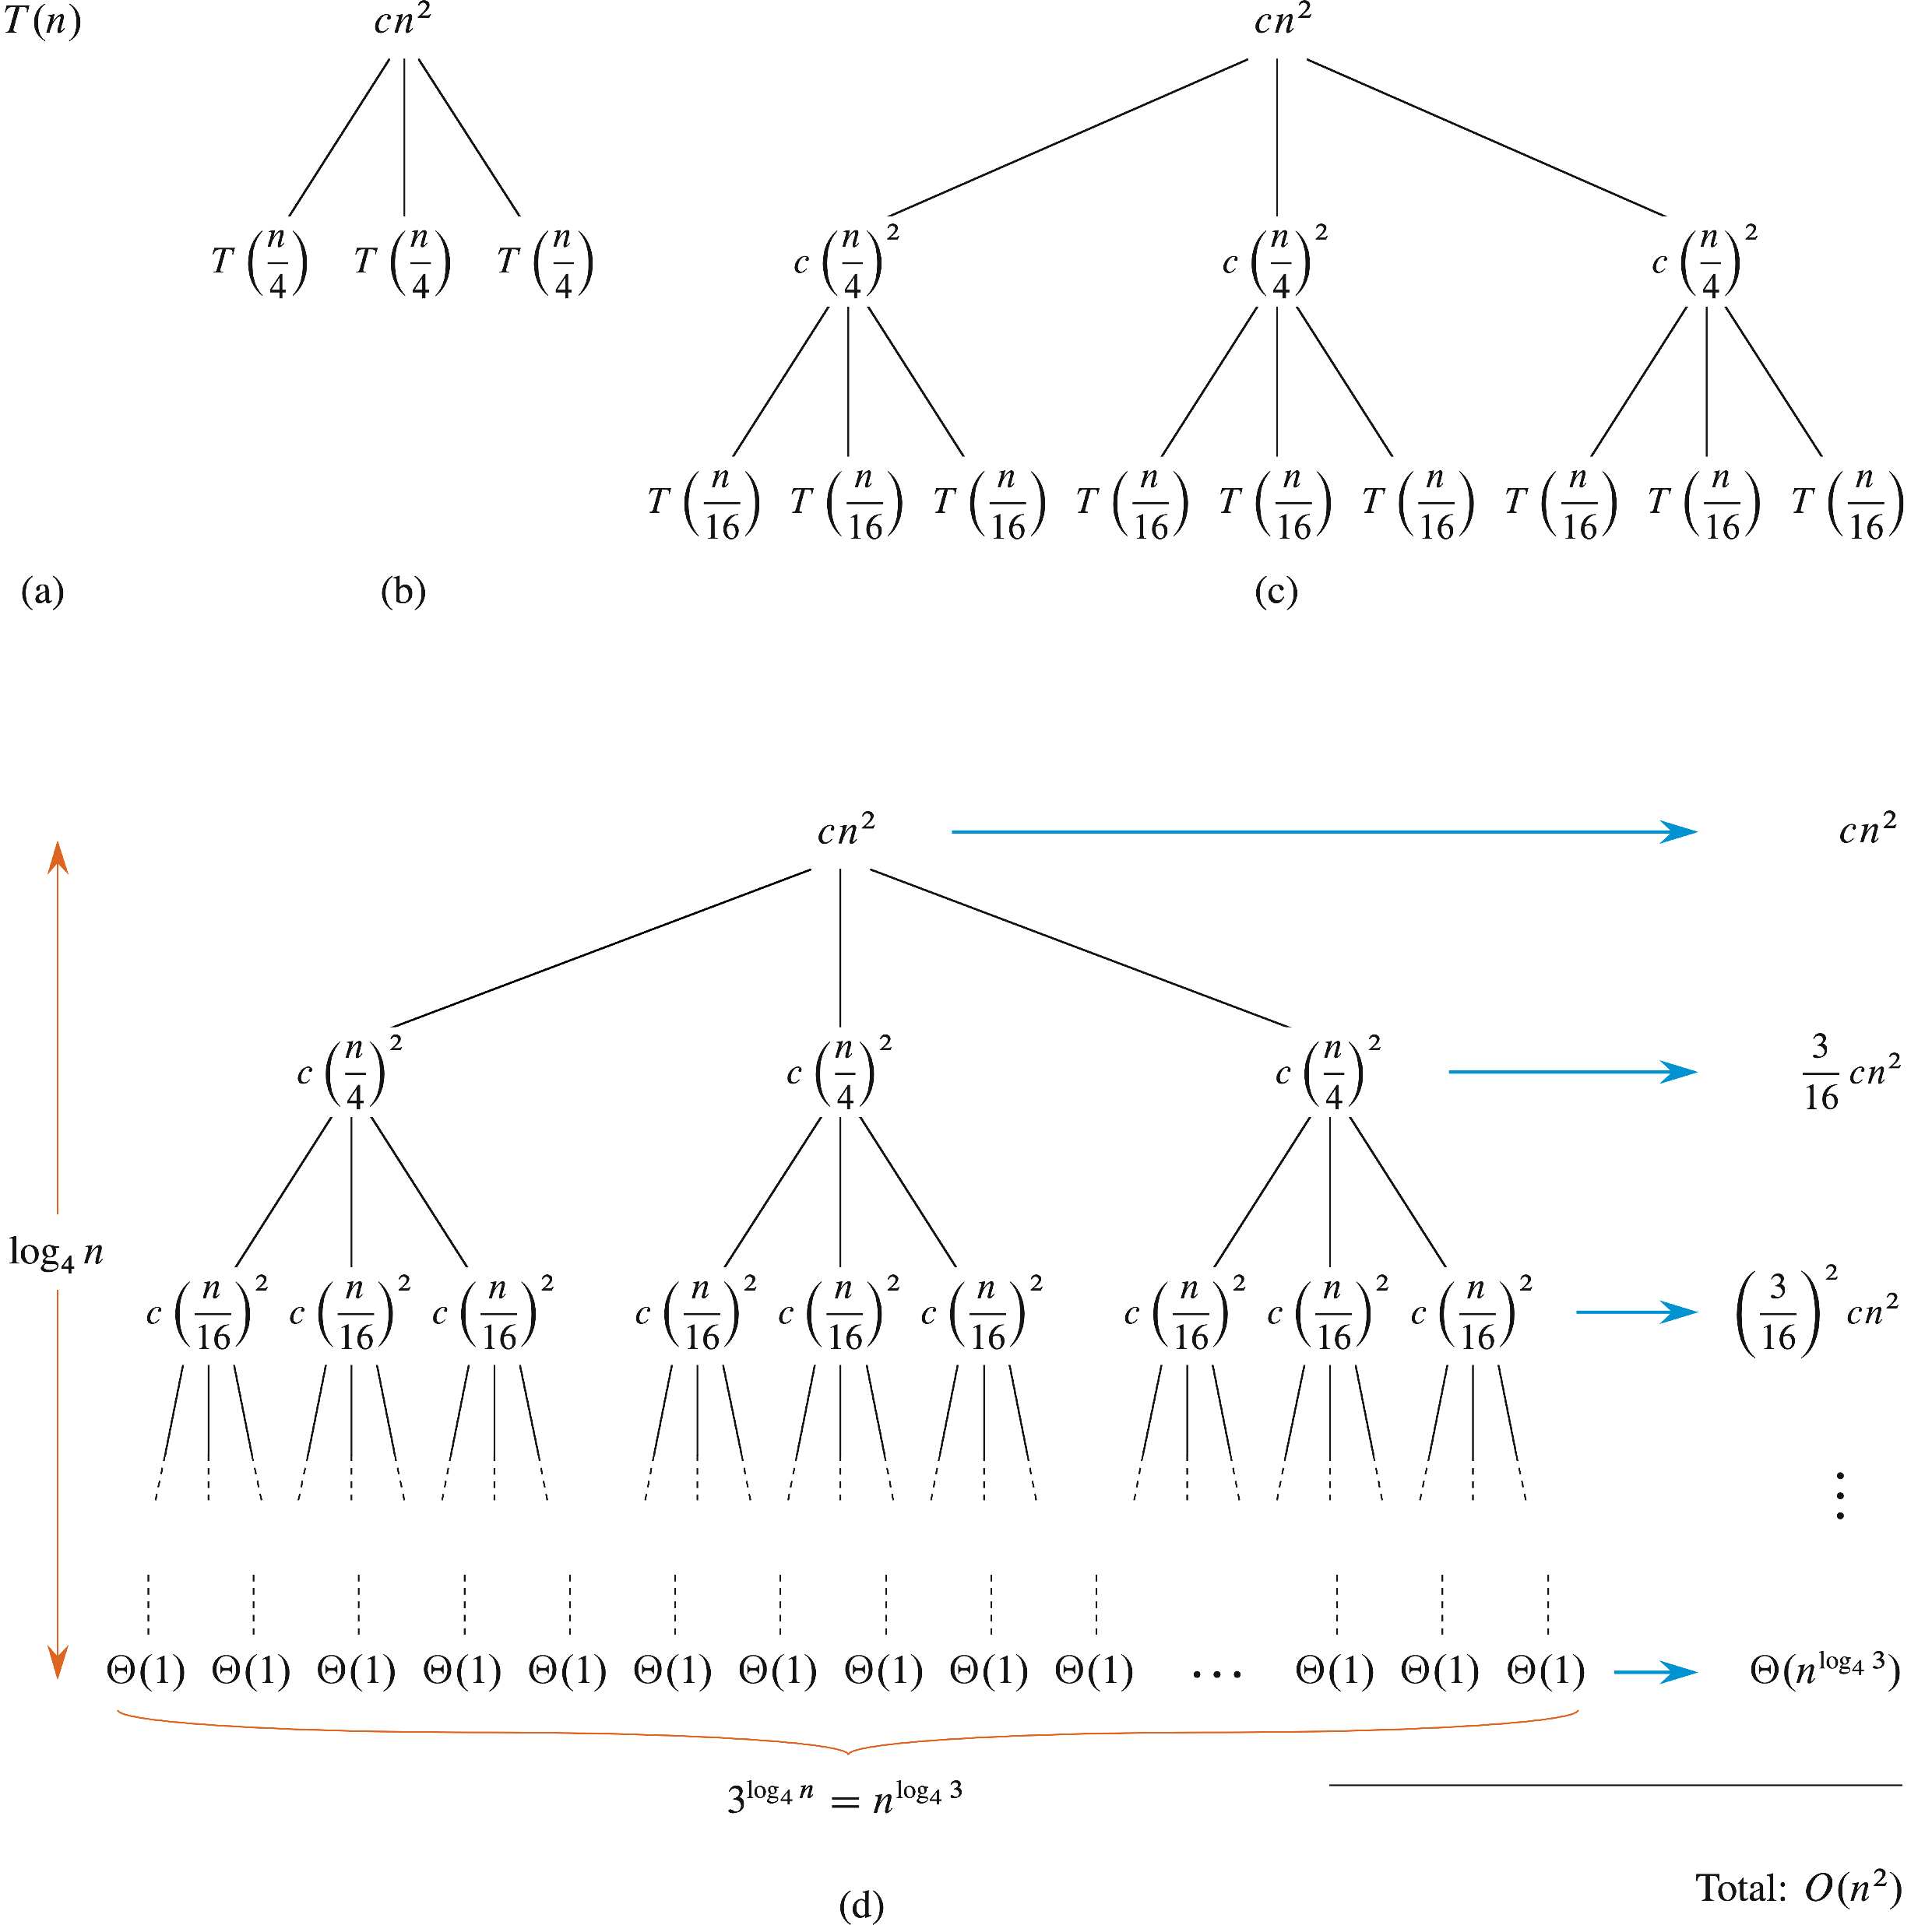
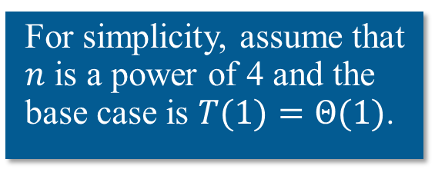
RECURSION TREES
Use to generate a guess. Then verify by substitution method.
Example:
For simplicity, assume that $n$ is a power of 4 and the base case is $T(1)=Θ(1)$.

Slide 20
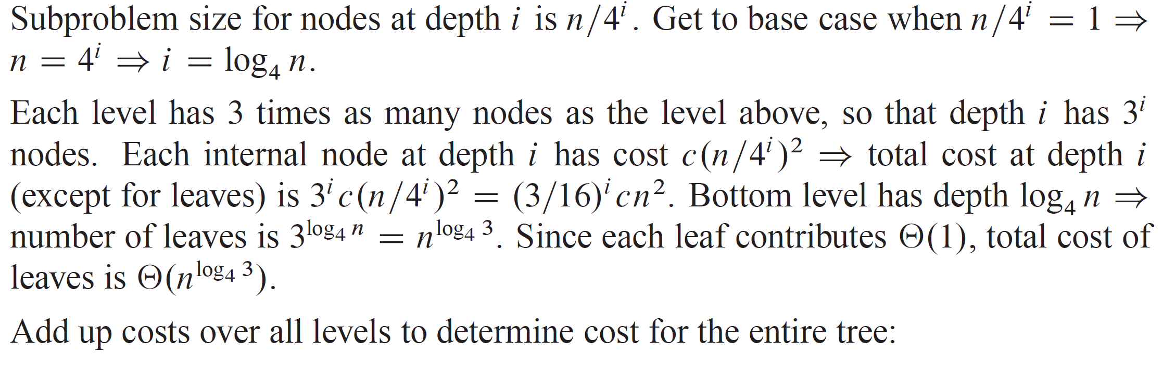
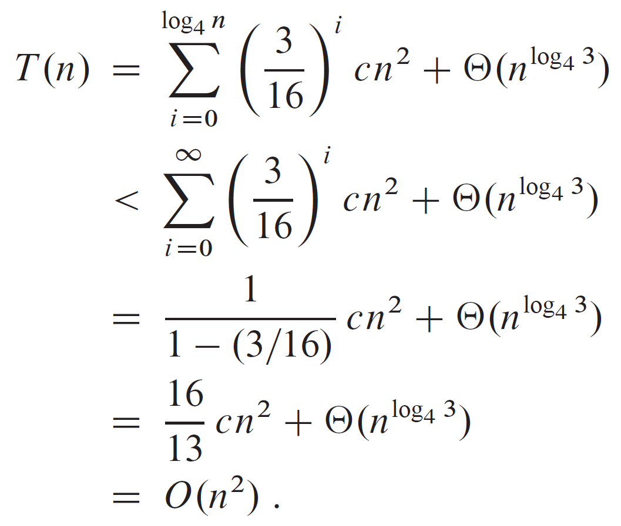
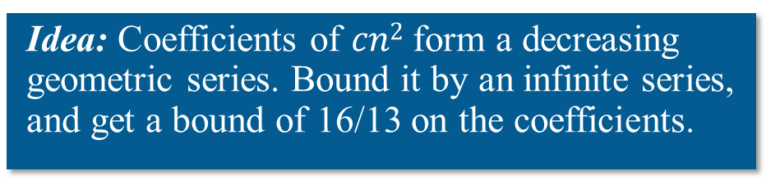
RECURSION TREES (continued)
Idea: Coefficients of $cn2$ form a decreasing geometric series. Bound it by an infinite series, and get a bound of 16/13 on the coefficients.

Slide 21
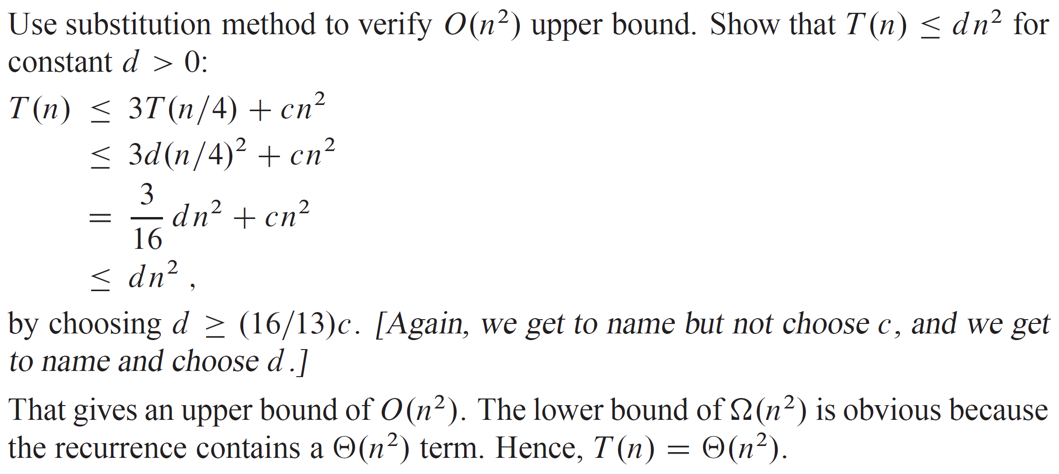
RECURSION TREES (continued)

Slide 22
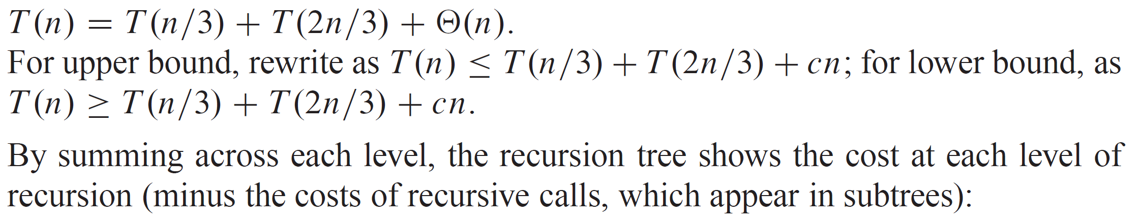
RECURSION TREES (continued)
Irregular Example:

Slide 23
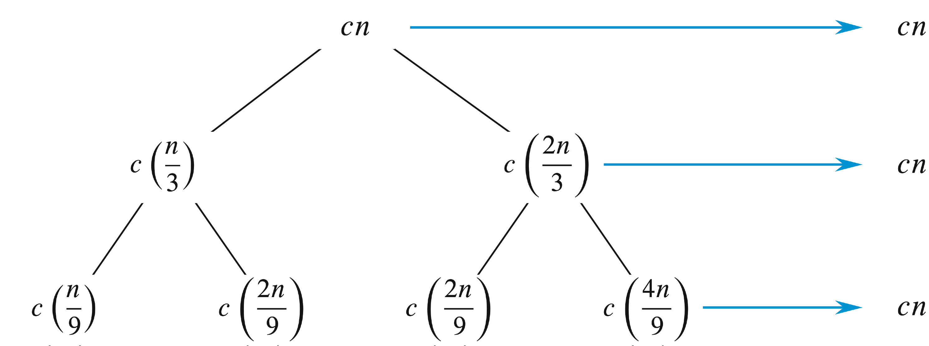
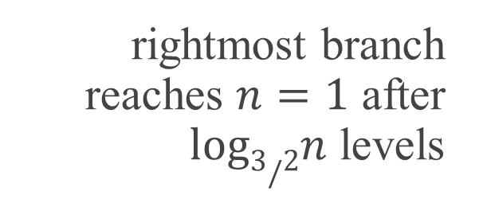
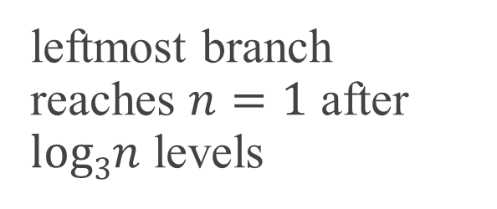
RECURSION TREES (continued)
Irregular Example:
leftmost branch reaches $n=1$ after $log3n$ levels
rightmost branch reaches $n=1$ after $log3/2n$ levels

Slide 24
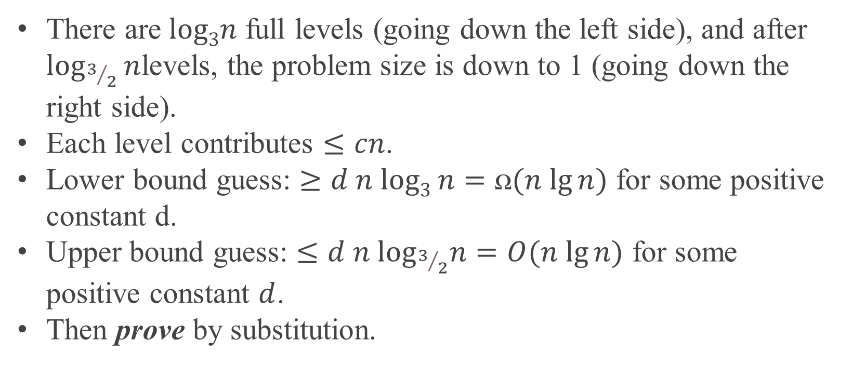
RECURSION TREES (continued)
Irregular Example:
There are $log3n$ full levels (going down the left side), and after $\log_{3/2}{n}$levels, the problem size is down to 1 (going down the right side).
Each level contributes $≤cn$.
Lower bound guess: $≥d n log3 n=ꭥ(n lg⁡n)$ for some positive constant d.
Upper bound guess: $≤d n\log_{3/2}n=O(n lg⁡n)$ for some positive constant $d$.
Then prove by substitution.

Slide 25
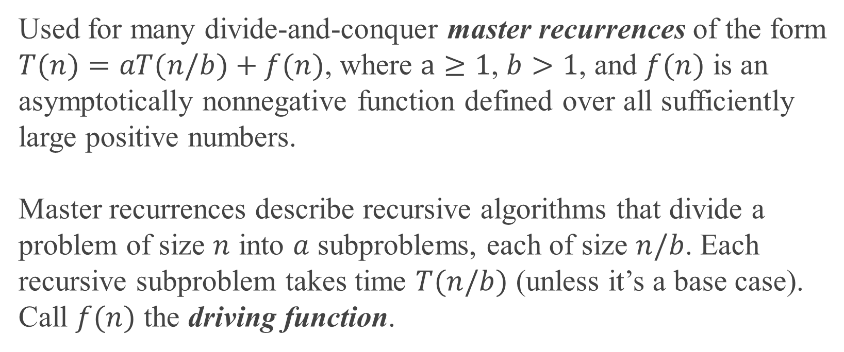
MASTER METHOD
Used for many divide-and-conquer master recurrences of the form
$T(n)=aT(n/b)+f(n)$, where $a≥1$, $b>1$, and $f(n)$ is an asymptotically nonnegative function defined over all sufficiently large positive numbers.
Master recurrences describe recursive algorithms that divide a problem of size $n$ into $a$ subproblems, each of size $n/b$. Each recursive subproblem takes time $T(n/b)$ (unless it’s a base case). Call $f(n)$ the driving function.

Slide 26
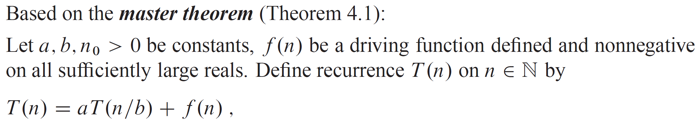
MASTER METHOD (continued)

Slide 27
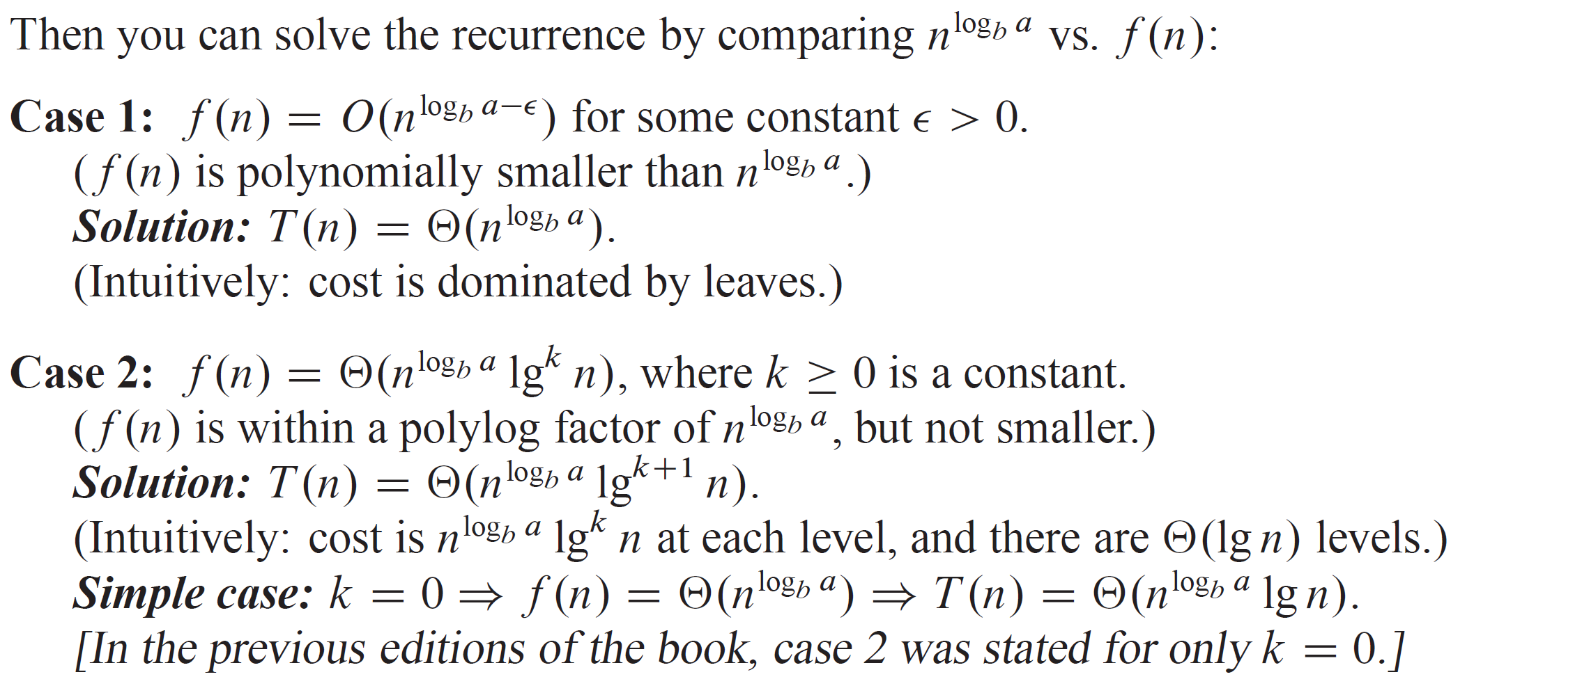
MASTER METHOD (continued)

Slide 28
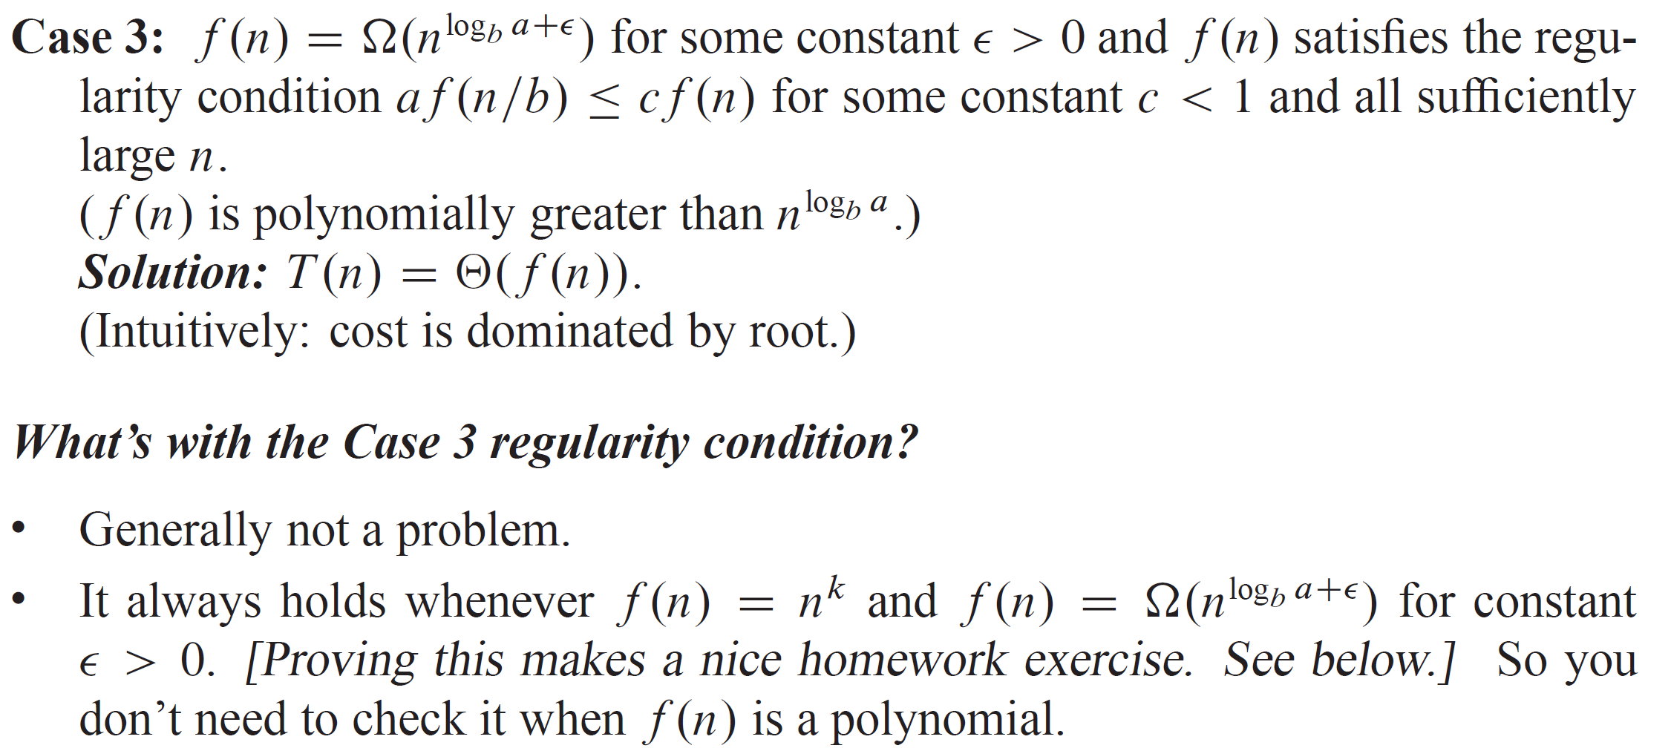
MASTER METHOD (continued)

Slide 29

MASTER METHOD (continued)
Call $n^{\log_{b}{a}}$ the watershed function. Master method compares the driving function $f(n)$ with the watershed function $n^{\log_{b}{a}}$.
If the watershed function grows polynomially faster than the driving function, then case 1 applies.
If the driving function grows polynomially faster than the watershed function and the regularity condition holds, then case 3 applies.
There are gaps between cases 1 and 2 and between cases 2 and 3.

Slide 30
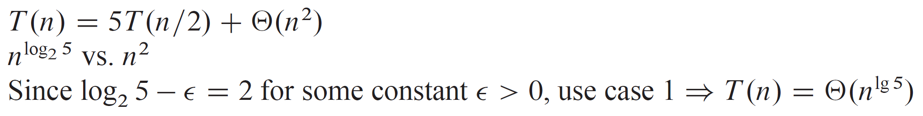

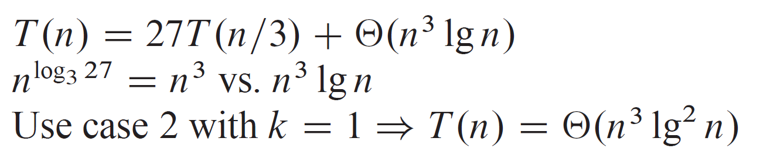

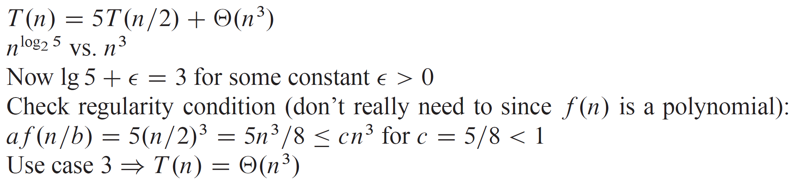

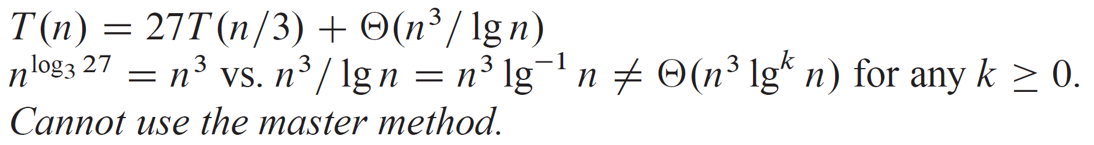

MASTER METHOD EXAMPLES

Slide 31
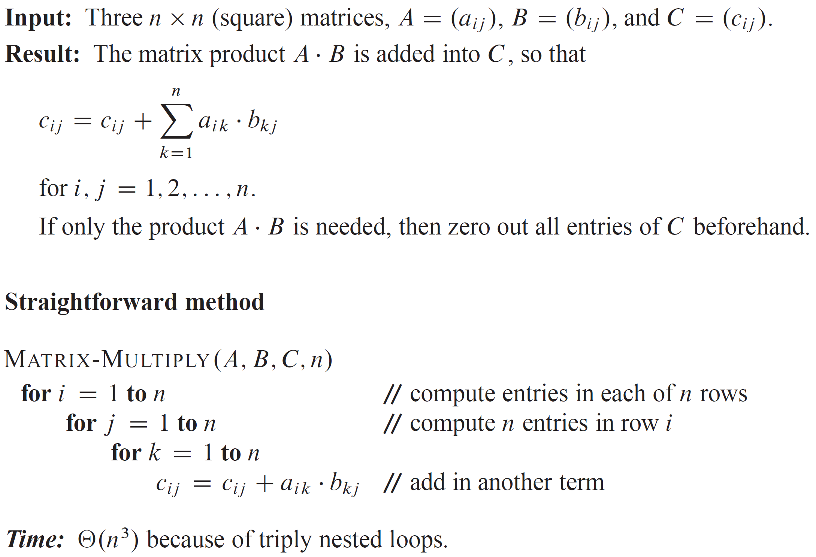
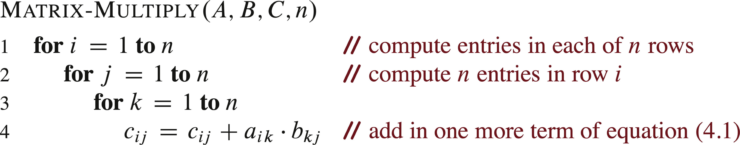
MULTIPLYING SQUARE MATRICES

Slide 32
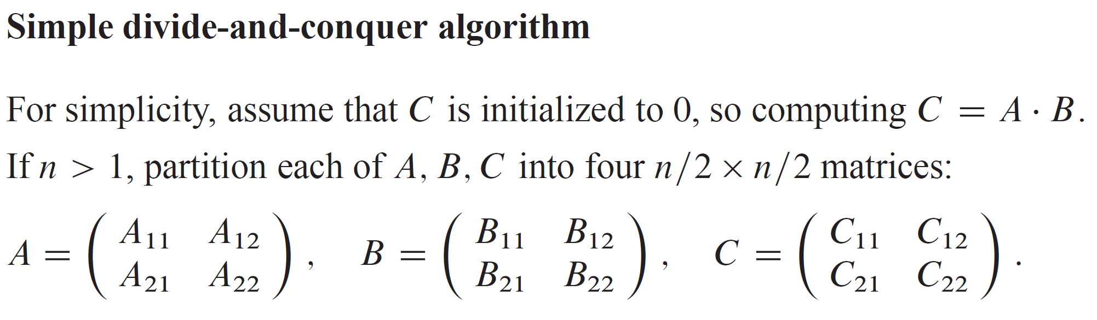
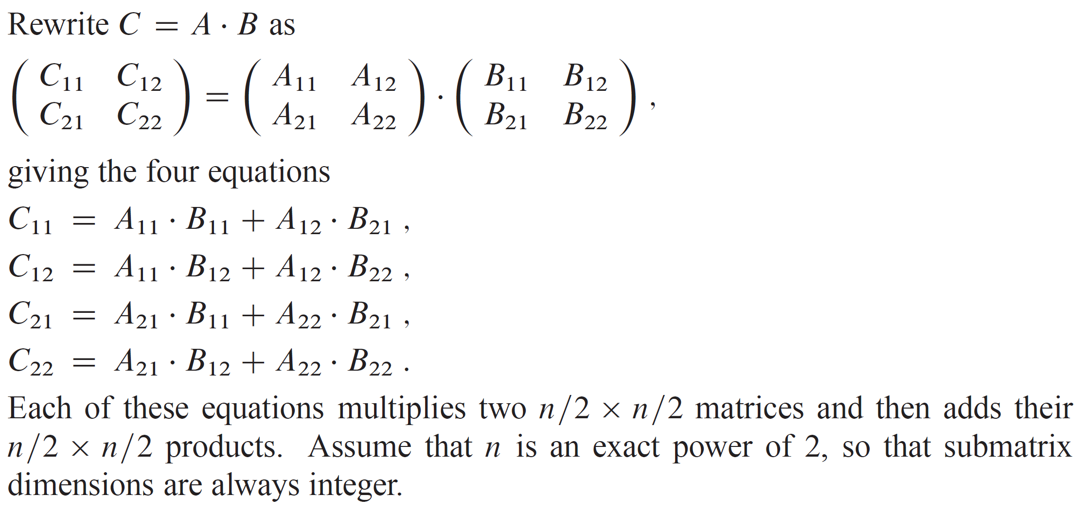
SIMPLE DIVIDE-AND-CONQUER ALGORITHM

Slide 33
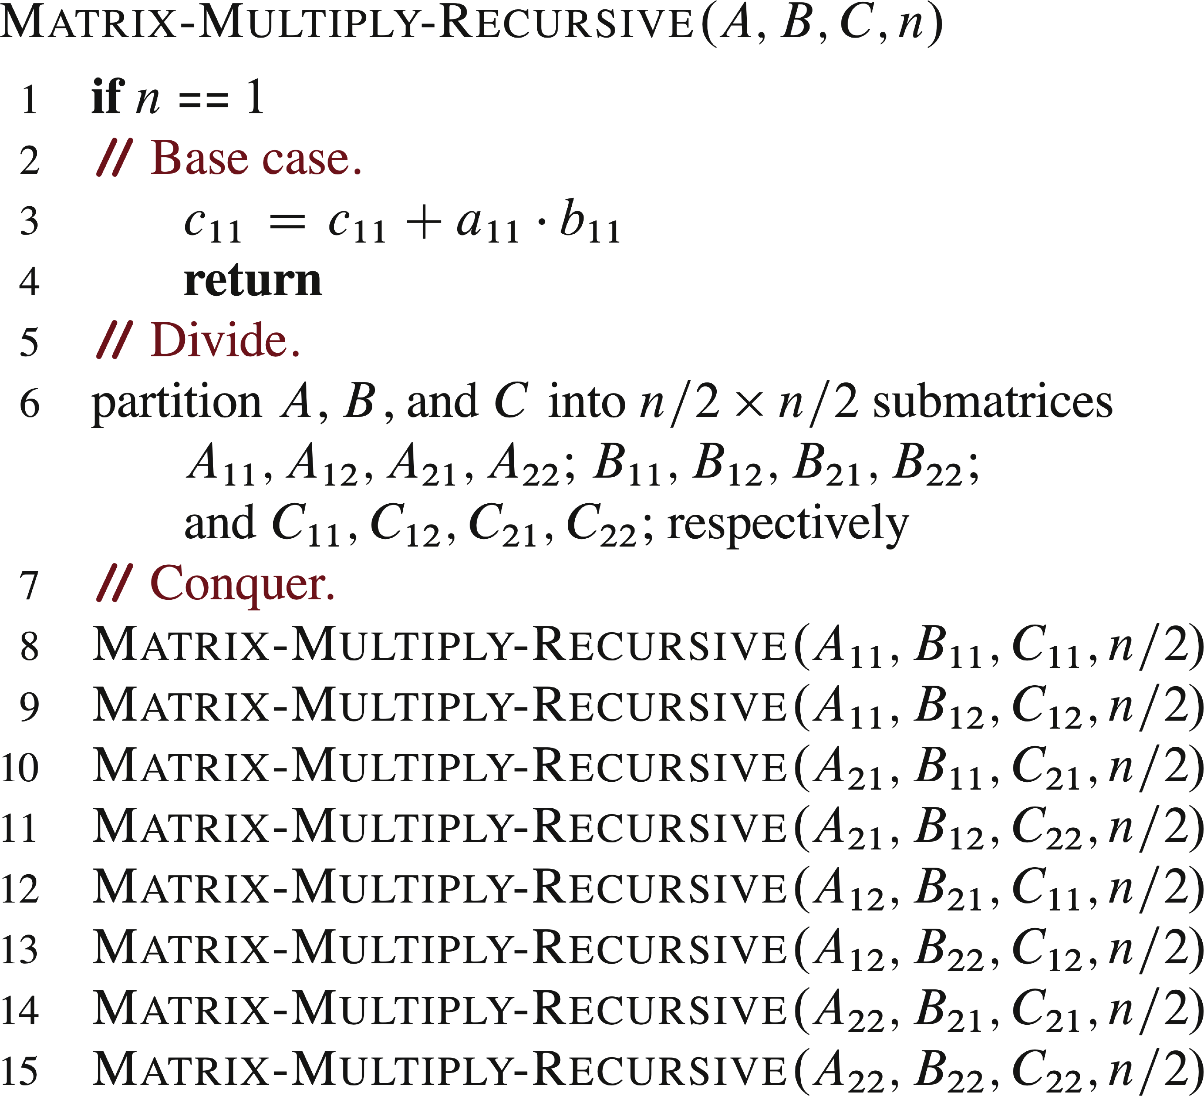
SIMPLE DIVIDE-AND-CONQUER ALGORITHM (continued)
Use these equations to get a divide-and-conquer algorithm:
The book briefly discusses the question of how to avoid copying entries when partitioning matrices. Can partition matrices without copying entries by instead using index calculations.

Slide 34
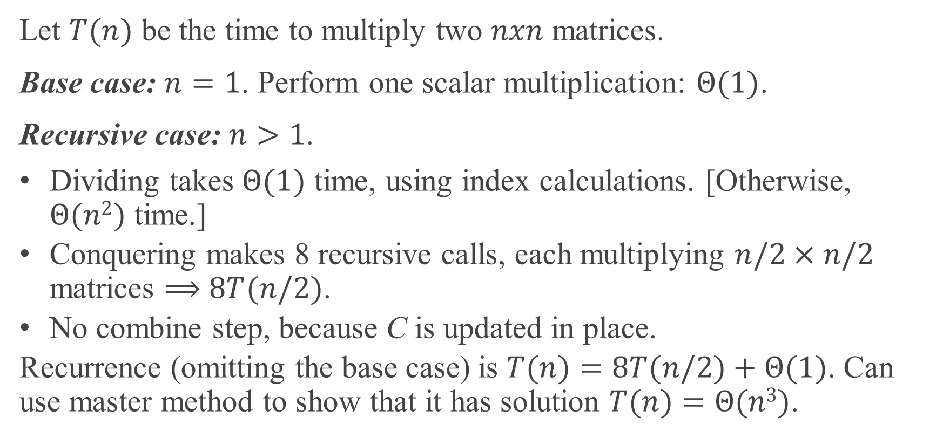
ANALYSIS
Let $T(n)$ be the time to multiply two $nxn$ matrices.
Base case: $n=1$. Perform one scalar multiplication: $Θ(1)$.
Recursive case: $n>1$.
Dividing takes $Θ(1)$ time, using index calculations. [Otherwise, $Θ(n2)$ time.]
Conquering makes 8 recursive calls, each multiplying $n/2×n/2$ matrices $⟹$ $8T(n/2)$.
No combine step, because C is updated in place.
Recurrence (omitting the base case) is $T(n)=8T(n/2)+Θ(1)$. Can use master method to show that it has solution $T(n)=Θ(n3)$.

Slide 35
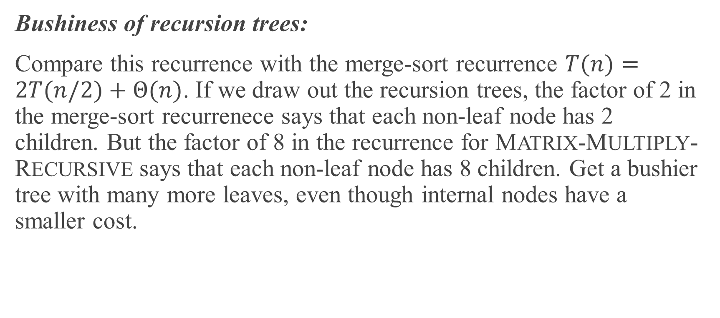
ANALYSIS (continued)
Bushiness of recursion trees:
Compare this recurrence with the merge-sort recurrence $T(n)=2T(n/2)+Θ(n)$. If we draw out the recursion trees, the factor of 2 in the merge-sort recurrenece says that each non-leaf node has 2 children. But the factor of 8 in the recurrence for MATRIX-MULTIPLY-RECURSIVE says that each non-leaf node has 8 children. Get a bushier tree with many more leaves, even though internal nodes have a smaller cost.

Slide 36
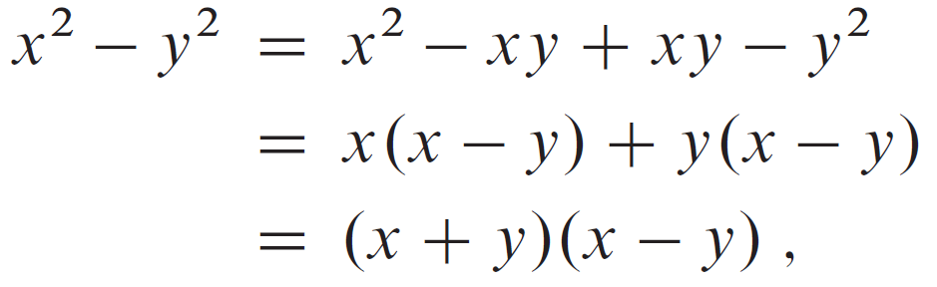
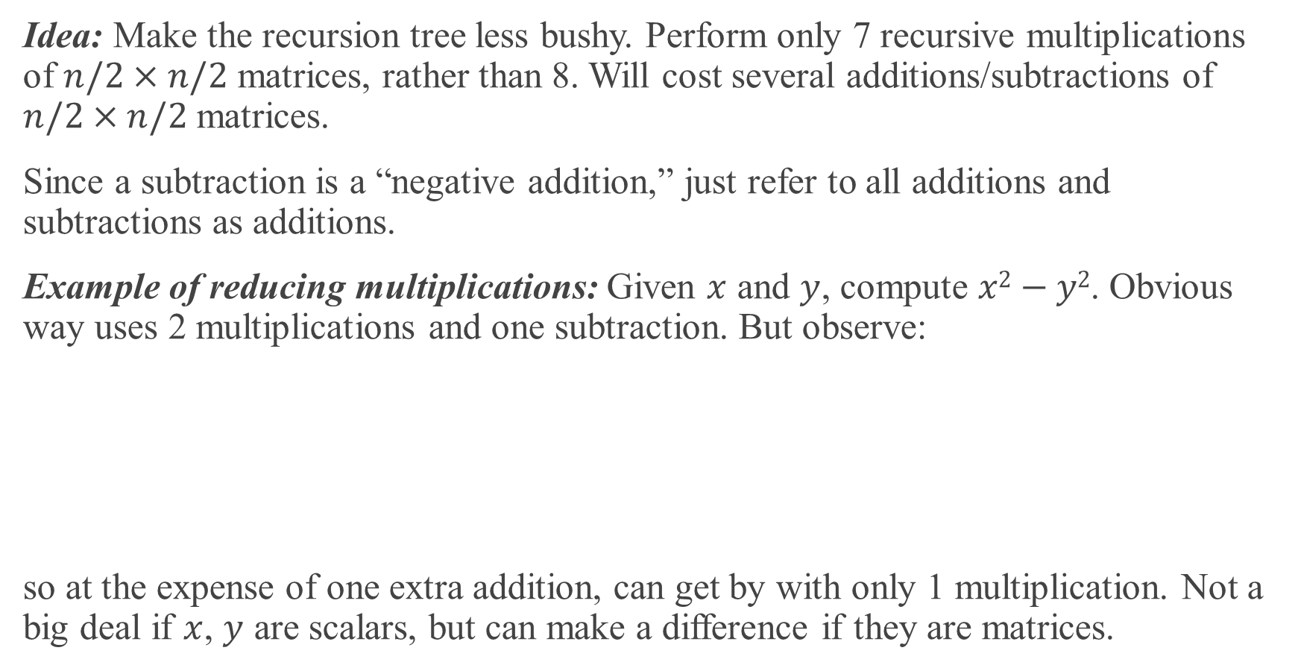
STRASSEN’S ALGORITHM
Idea: Make the recursion tree less bushy. Perform only 7 recursive multiplications of $n/2×n/2$ matrices, rather than 8. Will cost several additions/subtractions of $n/2×n/2$ matrices.
Since a subtraction is a “negative addition,” just refer to all additions and subtractions as additions.
Example of reducing multiplications: Given $x$ and $y$, compute $x2−y2$. Obvious way uses 2 multiplications and one subtraction. But observe:
so at the expense of one extra addition, can get by with only 1 multiplication. Not a big deal if $x$, $y$ are scalars, but can make a difference if they are matrices.

Slide 37
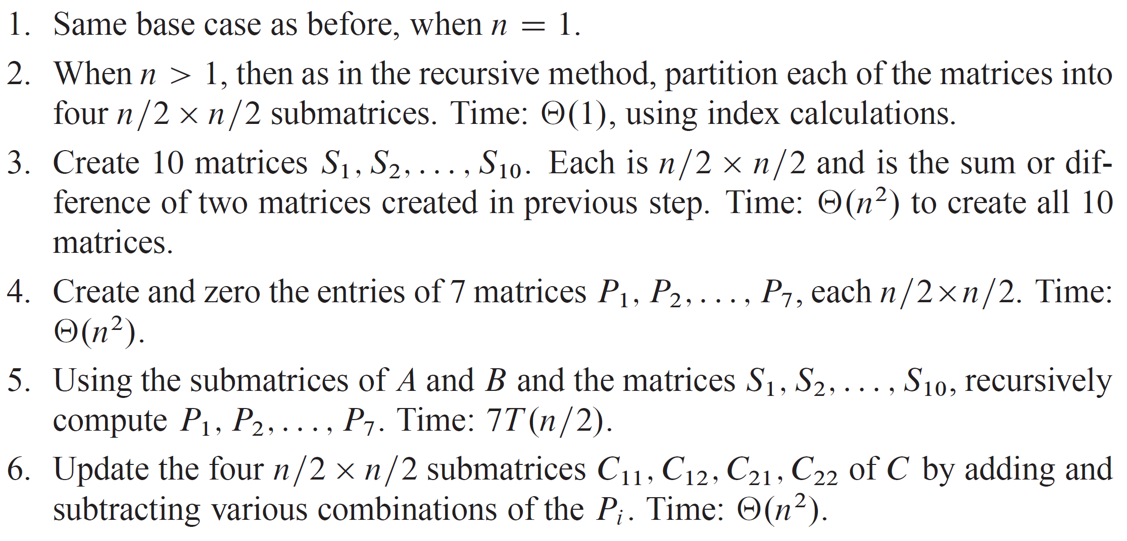
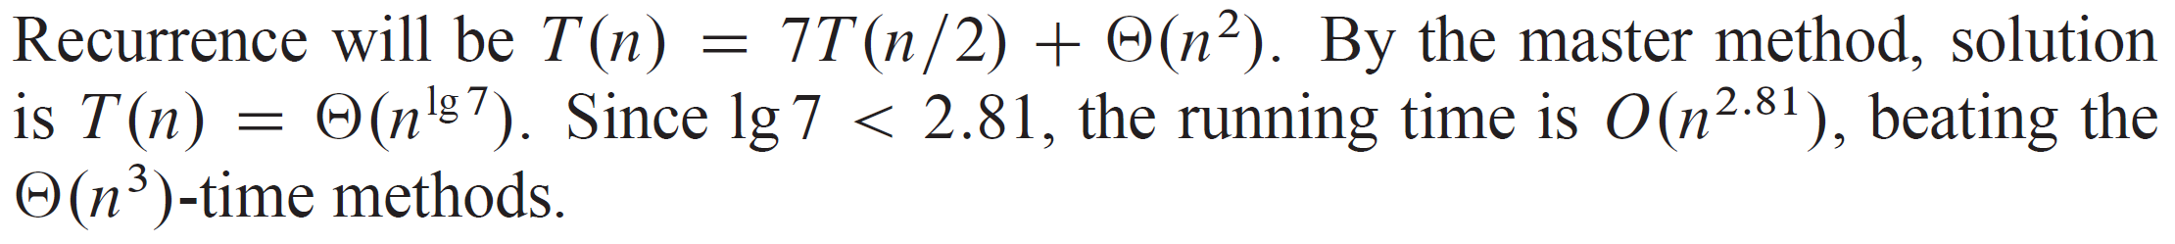
STRASSEN’S ALGORITHM (continued)
The algorithm:
Analysis

Slide 38
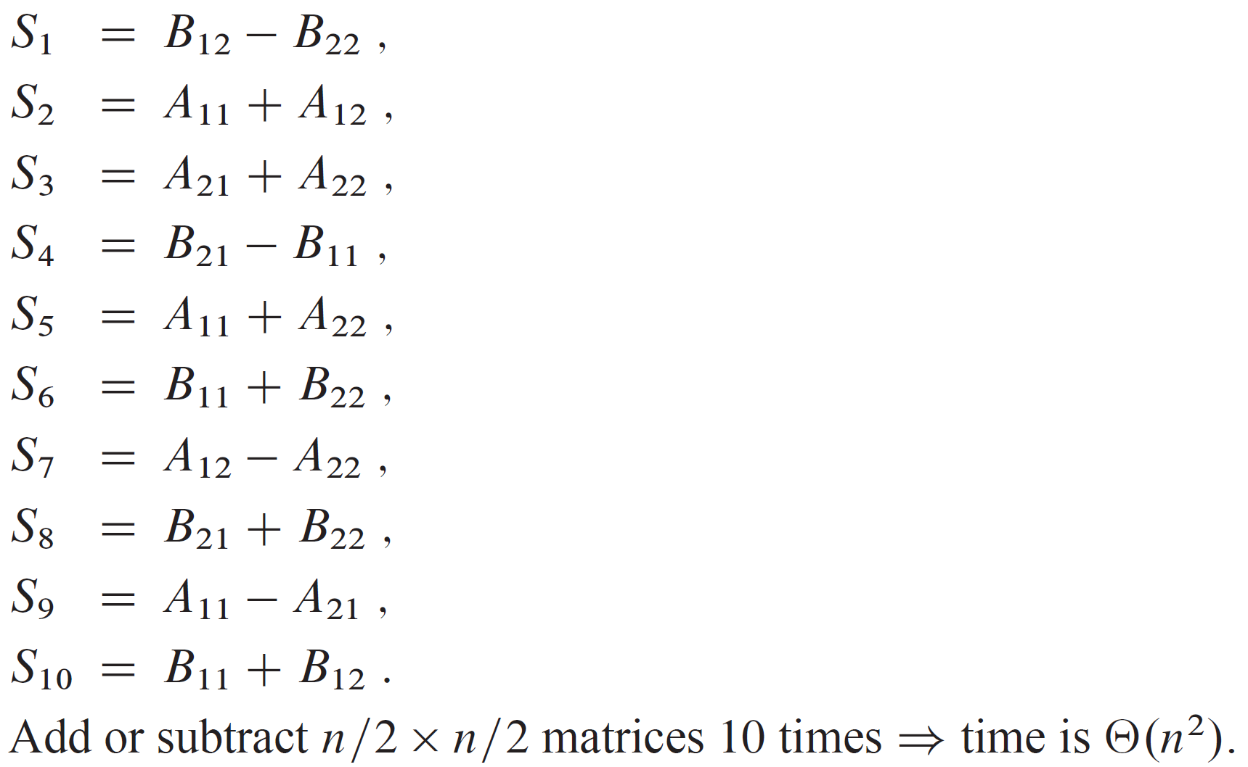
STRASSEN’S ALGORITHM (continued)
Details
Step 2: Create the 10 matrices

Slide 39

STRASSEN’S ALGORITHM (continued)
Step 4: Compute the 7 matrices

Slide 40


STRASSEN’S ALGORITHM (continued)
Step 5: Add and subtract the $Pi$ to construct submatrices of C:

Slide 41

EXAMPLE
Example of how C₁₁ is reconstructed using additions and the previously defined P and S matrices.
All four examples are fully worked out in the text.

Slide 42

THEORETICAL AND PRACTICAL NOTES
Strassen’s algorithm was the first to beat $Θ(n3)$ time, but it’s not the asymptotically fastest known. A method by Coppersmith and Winograd runs in $O\left(n^{2.376}\right)$ time. Current best asymptotic bound (not practical) is $O\left(n^{2.37286}\right)$.
Practical issues against Strassen’s algorithm:
Higher constant factor than the obvious $Θ(n3)$-time method.
Not good for sparse matrices.
Not numerically stable: larger errors accumulate than in the obvious method.
Submatrices consume space, especially if copying.

Slide 43

EXAMPLES OF RECURRENCES ARISING FROM DIVIDE-AND-CONQUER ALGORITHMS

